Slide 1
Russian Losses In Ukraine and Media Silence
Group 14: Alexander Burt, Abigail Audlin

Slide 2
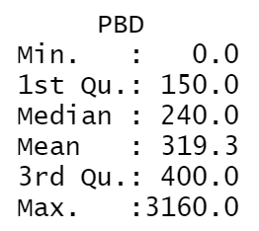
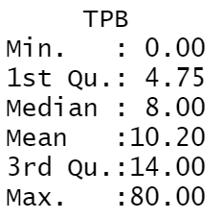
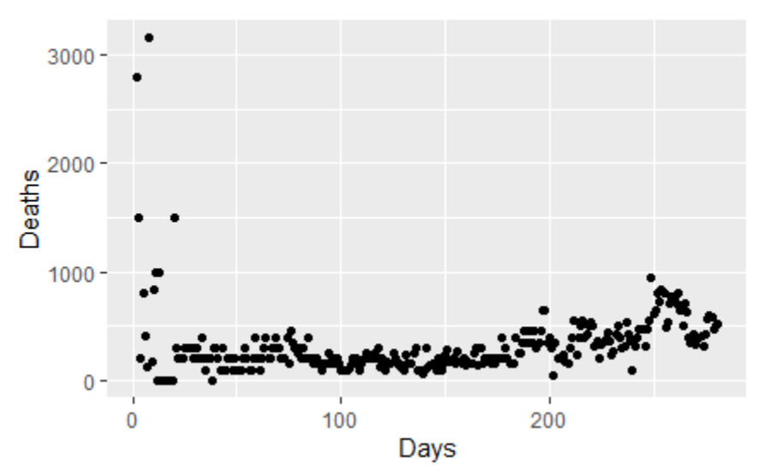
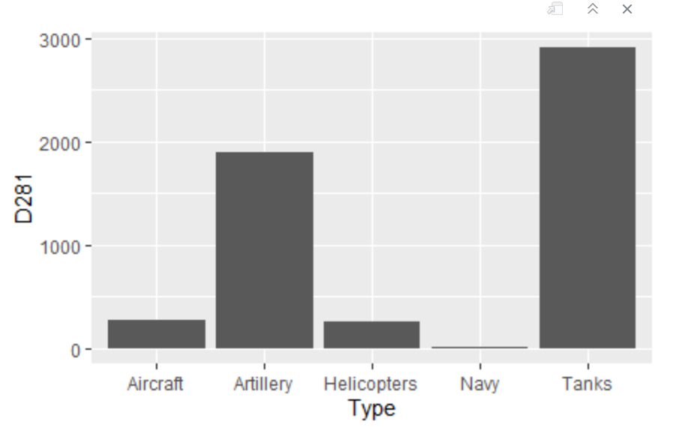
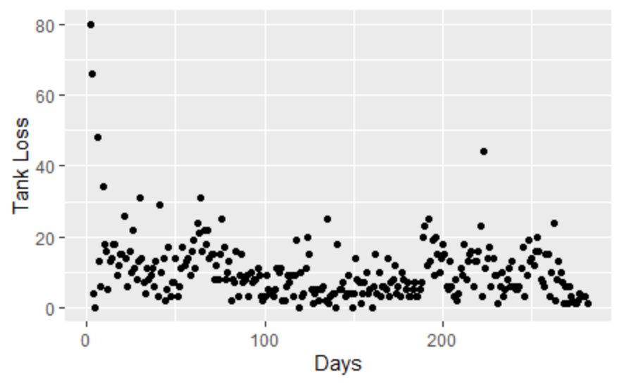
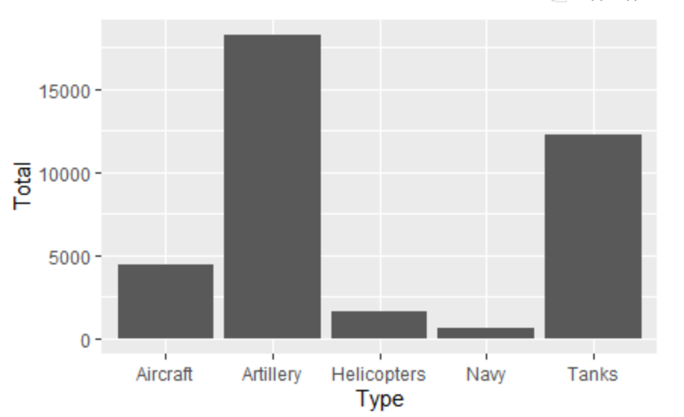
Descriptive Slide
We analyzed the first 281 days of the Russia/Ukraine Conflict with Russian Losses
Our results were surprising
We used Web scrapping techniques from three different sites and Google Trends (Next Slide) to show overall totals and popular searches
We needed to clean our data and add variables that would show losses over time
We checked both human losses and equipment losses since the beginning of the war
We also checked with the total number the Russian Armed Forces had as of 2020 through Web Scrapping

Slide 3
